Slide 1
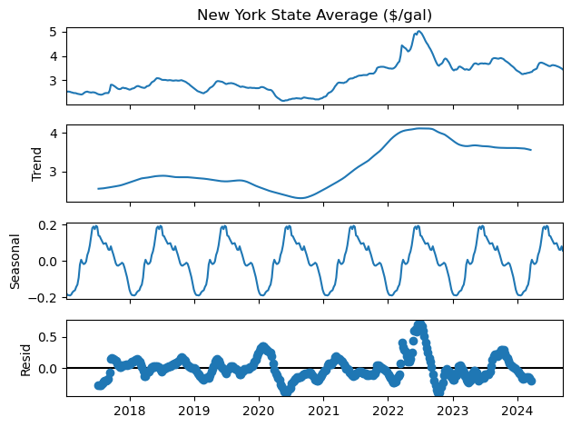
Data Preprocessing
We remove trends and seasonality in the data
Trends are removed by applying a 12-week moving average (e.g., quarterly smoothing)
Data is averaged to a weekly resolution
This keeps the most amount of information while ensuring equal sample spacing

Slide 2
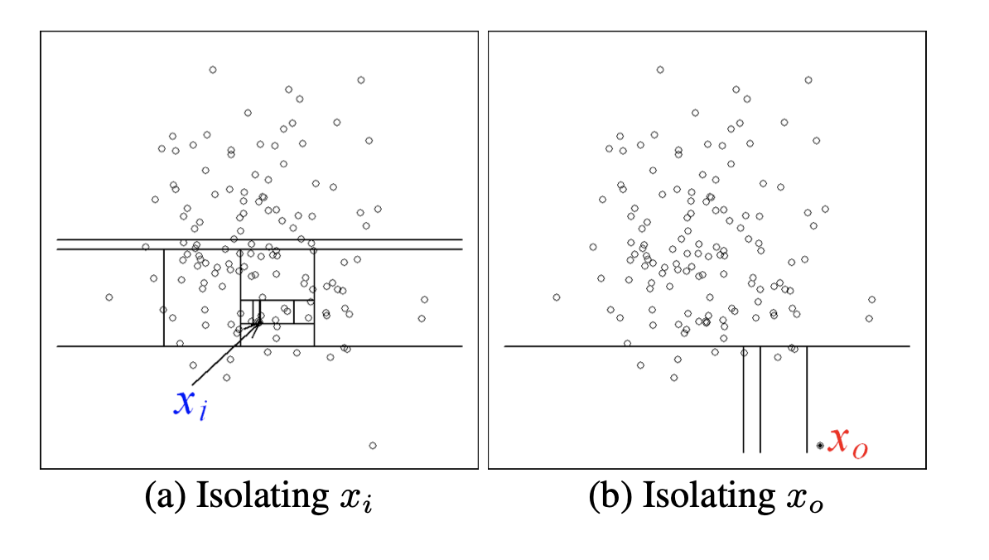
Method 1: Isolation Forest
Isolation forests show promise in detecting anomalous patterns in time series data, Liu et al. (2008)
This method aims to isolate anomalous points in data through recursively generating partitions of the data across all it’s features
Iteration stops once a maximum tree depth specified by the algorithm is reached
On test time, anomaly scores are determined based on the normalized path lengths
Points requiring less path lengths to split are more anomalous, as they would be in sparser regions of the data
Liu, et al. (2008)

Slide 3
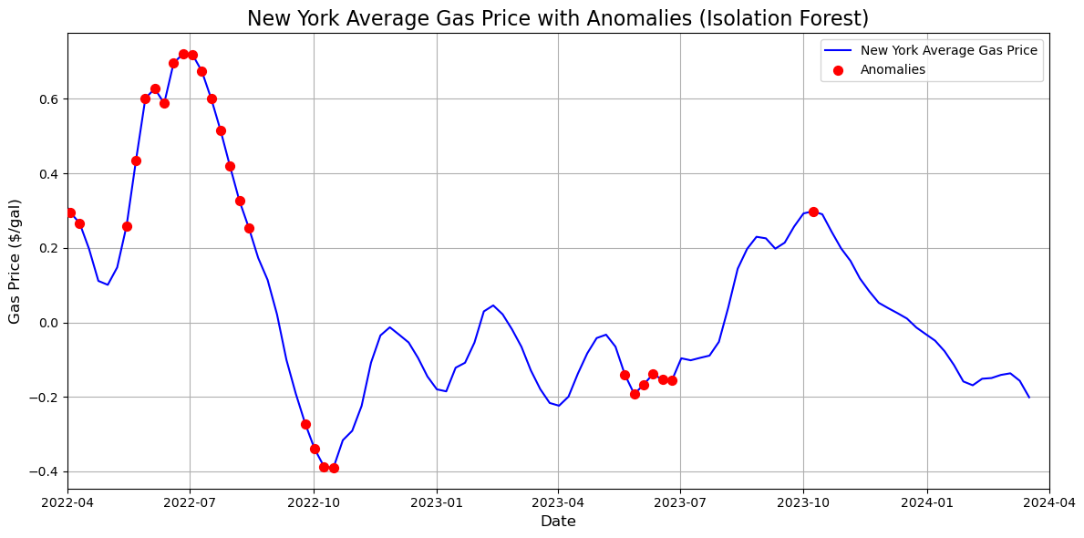
Method 1: Isolation Forest
We filter for the 95th percentile in anomaly scores as our thresholding value
Model is fit to 2015-2021 data and tested on 2022-2024 data
The fit model identifies large changes in gas price residuals as anomalous, which is behavior we would expect
Highest concentration of anomalies in 2022, which is consistent with our 1-d trend decomposition earlier

Slide 4
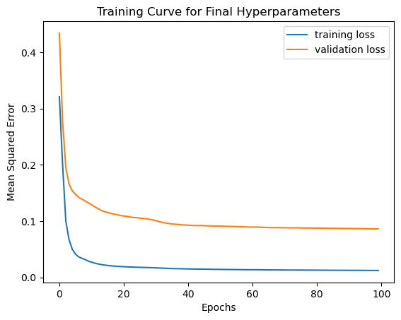
Method 2: LSTM Autoencoder
We also use an LSTM autoencoder, trained on reconstructing the data before 2022, and tested on data from then until 2024
Due to size of training data, we perform 5-fold cross-validation with the data from 2015-2022
Hyperparameters tuned: hidden dimension and learning rate
Final hyperparameters used:
Hidden dimension: 64, learning rate: 0.001, batch size: 32, epochs: 100

Slide 5
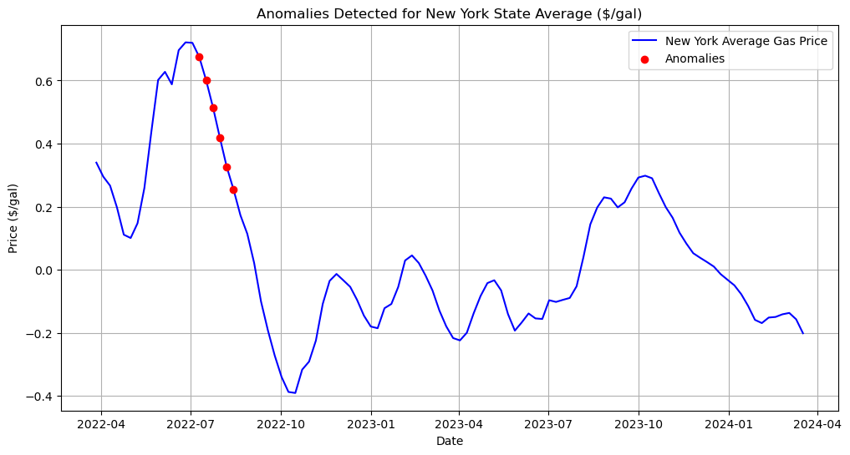
Method 2: LSTM Autoencoder
Anomaly scores correspond to the MSE reconstruction error, tresholded according to the 95th percentile
Compared to the isolation forest, this model is much more conservative in it’s anomaly scores
Still flags the same downward trend in 2022 as anomalous

Slide 6
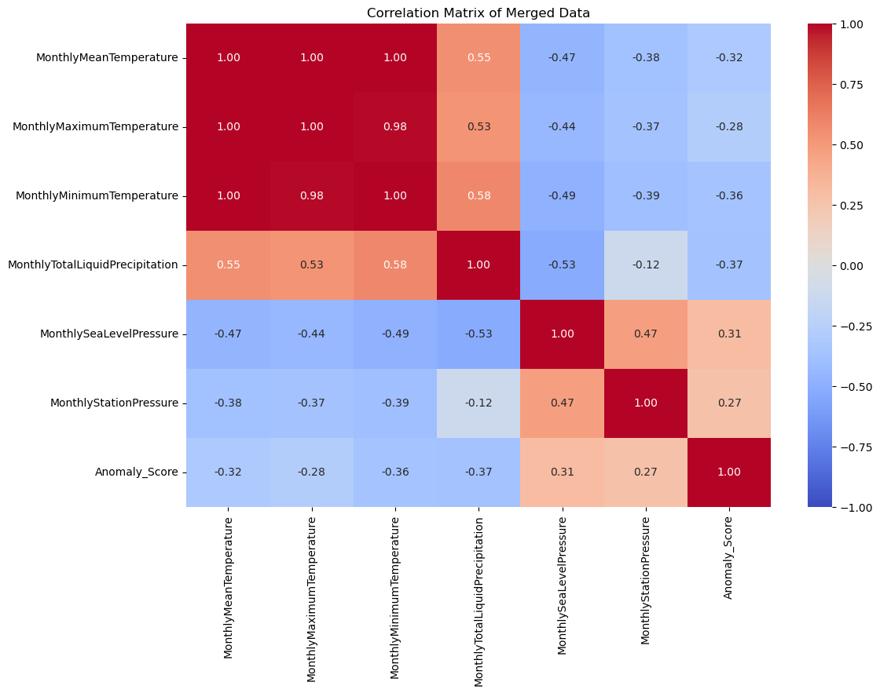
Incorporating Climate Effects
We notice that both models indicate anomalous patterns in gas prices in 2022. One hypothesis is that this is correlated to climate patterns specific to 2022
To investigate further, we look into NOAA’s Local Climatology Dataset (LCD), which provides station temperature and pressure at a monthly resolution
Specifically, we use data from NWS Albany
The correlation matrix to the right shows possible connection between sea level pressure and anomaly score

Slide 7
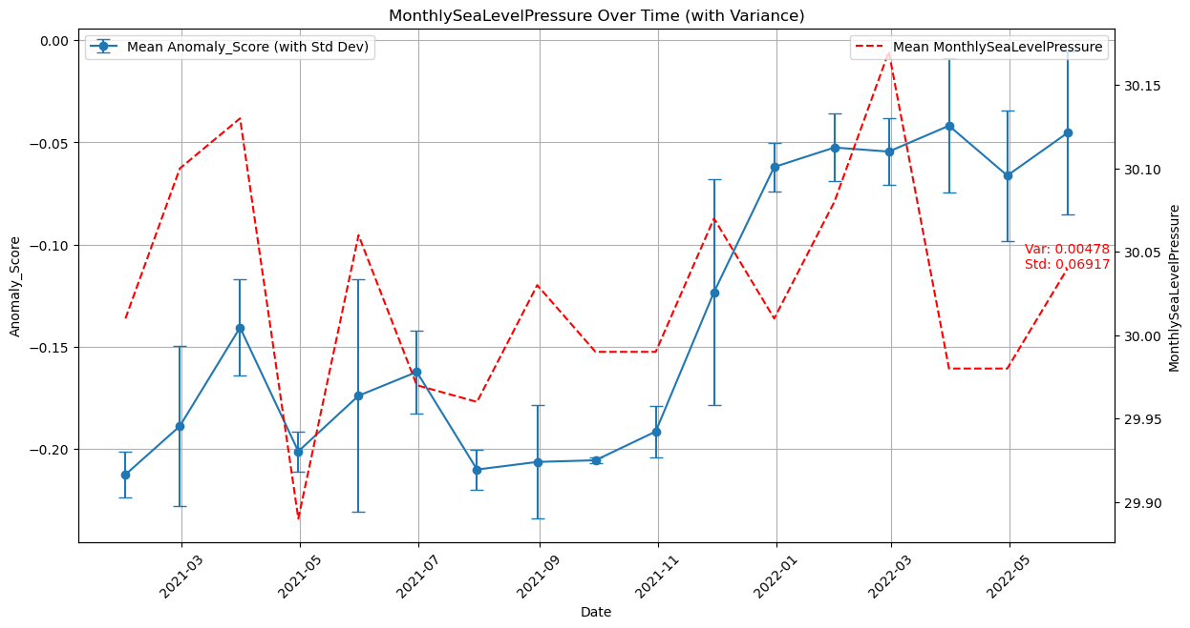
Incorporating Climate Effects
Sea level pressure variance is too high to make a conclusion
Would need more data across multiple NY state stations

Slide 8
References
F. T. Liu, K. M. Ting and Z. -H. Zhou, "Isolation Forest," 2008 Eighth IEEE International Conference on Data Mining, Pisa, Italy, 2008, pp. 413-422, doi: 10.1109/ICDM.2008.17
National Centers for Environmental Information. Local Climatological Data (LCD) Documentation. National Oceanic and Atmospheric Administration (NOAA), n.d., https://www.ncei.noaa.gov/pub/data/cdo/documentation/LCD_documentation.pdf.

